Slide 1
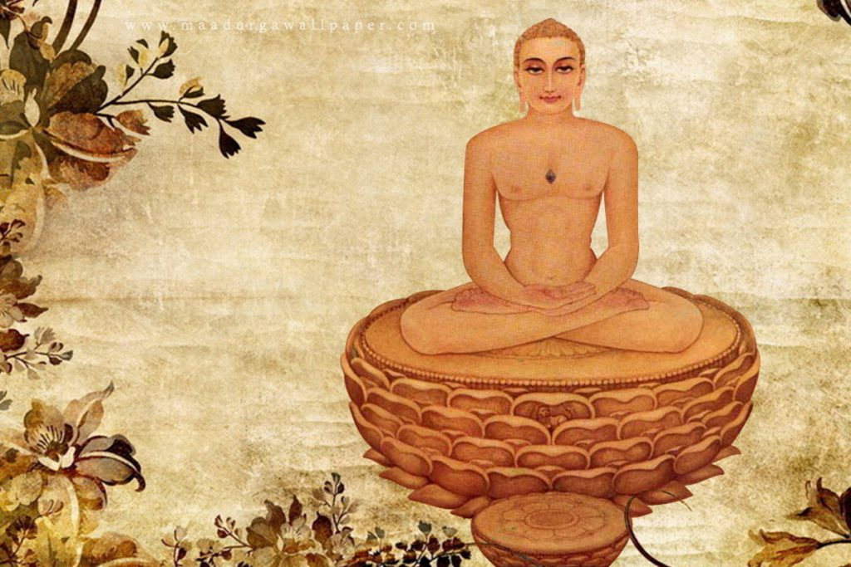
Essence of Jain Diwali – The Spiritual & The Festive

Slide 2
Diwali: Removal of Darkness in Jainism
Diwali is the most important festival for Indians. This is one festival that all Indians celebrate globally.
For Jains Diwali has an important significance. It is the Nirvaan Kalyanak of Bhagwan Mahavir, the day Mahavir attained Moksha. For us, as Jains 2 days are important, chaudas and amavas , 14th and 15th day of kartik sud month. Mahavir gave his last sermon for 48 hours on these 2 days and attained Nirvana on Amavas night. And lastly Gautam Swami attaining Kevalgyan, complete knowledge, after Mahavir went to Moksh. This day is celebrated as a new beginning, a new year.
Mahavir was like the Sun, spreading the light through true knowledge. When the sun sets, the world is surrounded by darkness, the same way, when the source of light, Mahavir left this world, people felt lost and left with deep sense of sadness. The kings and celestial beings thought that now that our source of light, Mahavir, has left, we will have to make the effort and bring light in our lives, by following the principles of Mahavir. To remove the physical darkness people lit diyas as a symbol to create light.
Many Jains, keep Chhat, 2 days fast and do Jaap to celebrate Diwali. Many celebrate New Year with family and friends with good food, with different kind of sweets and savouries.
All festivals in Jainism are practiced/ celebrated with Tap (fasting) and Tyaag (renouncing)– which help to broaden our boundaries of Ahimsa, of compassion. Reflection on one’s life instead of rejoicing with mindless eating or other mindless activities is the focus for Jain festivals.

Slide 3
Bringing Light and Sweetness to Our Lives
Somewhere we have to reflect: Can I bring light in my life by bringing darkness in the lives of other beings?
Are my lifestyle choices hurting any other beings, am I bringing suffering and pain to them? This Diwali we have to introspect and bring that change in our lives.
Jainism talks about External and Internal practices.
  Externally we light Diyas to remove the darkness.
  Internally, we have to remove the darkness, remove our karmas by practicing what Mahavir said, by practicing the principles of Jainism. The main tenet being Ahimsa.

Slide 4
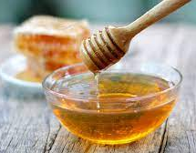
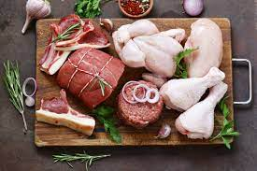
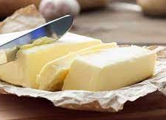

As Jains, we have to completely abstain from 4 Maha Vigais, Foods that come from violence, and are not permitted.
Honey
Meat
Butter
Alchol

Slide 5
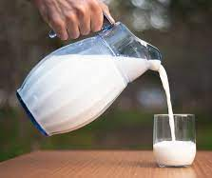
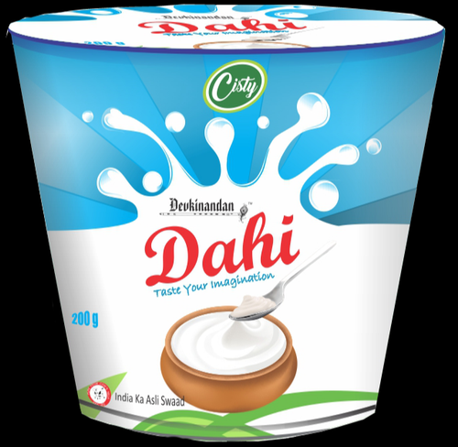
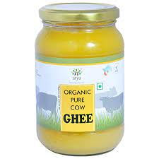
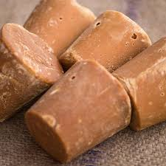
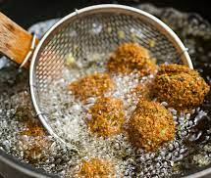
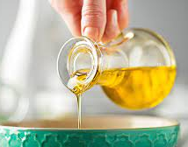
Laghu Vigai – 6 Passion creating Foods. Dairy industry involves violence and torture to cows,
5 sensed beings, and therefore dairy products such as milk, ghee and dahi
should be avoided
.
Milk
Ghee
Dahi/ yoghurt
Oil
Jaggery/ Sugar
Deep fried

Slide 6
Festivals in Diwali
There are different festivals during Diwali. They are:
1. Sharda maa Pujan – Sharda maa is also known as Goddess Saraswati who is the Goddess of knowledge.
On this day traders and businessmen do Puja of books.
It is closing the books of accounts by clearing all debts and starting a new accounting year.
2. Dhan Teras – Goddess Lakshmi, the Goddess of wealth.
Puja of Goddess Lakshmi to increase our wealth.
Dhan means wealth. When one aims to attain wealth, that wealth is usually used for the self and for one’s family. Living in the material world, we all need wealth. So let us aim to get wealth that is “Sadh Lakshmi”-
The discretion to use the wealth not just for self but also for upliftment of others. This wealth benefits the self, family and society in large.
Guna Lakshmi – With each Diwali, we should be growing not just monetarily but also bt The Wealth of Virtues. Over the yers we have to nurture the virtues of compassion, kindness, humility.
Moksh Lakshmi – The ultimate goal of liberation.

Slide 7
I leave you with 2 things to reflect on:
1. Can I bring light in my life by bringing darkness in the lives of other beings?
2. Celebrations of Jain Festivals start and end on a particular day but the ESSENCE is supposed to be intertwined in our daily life, helping us evolve as spiritual beings, continually to each Diwali.

Slide 8
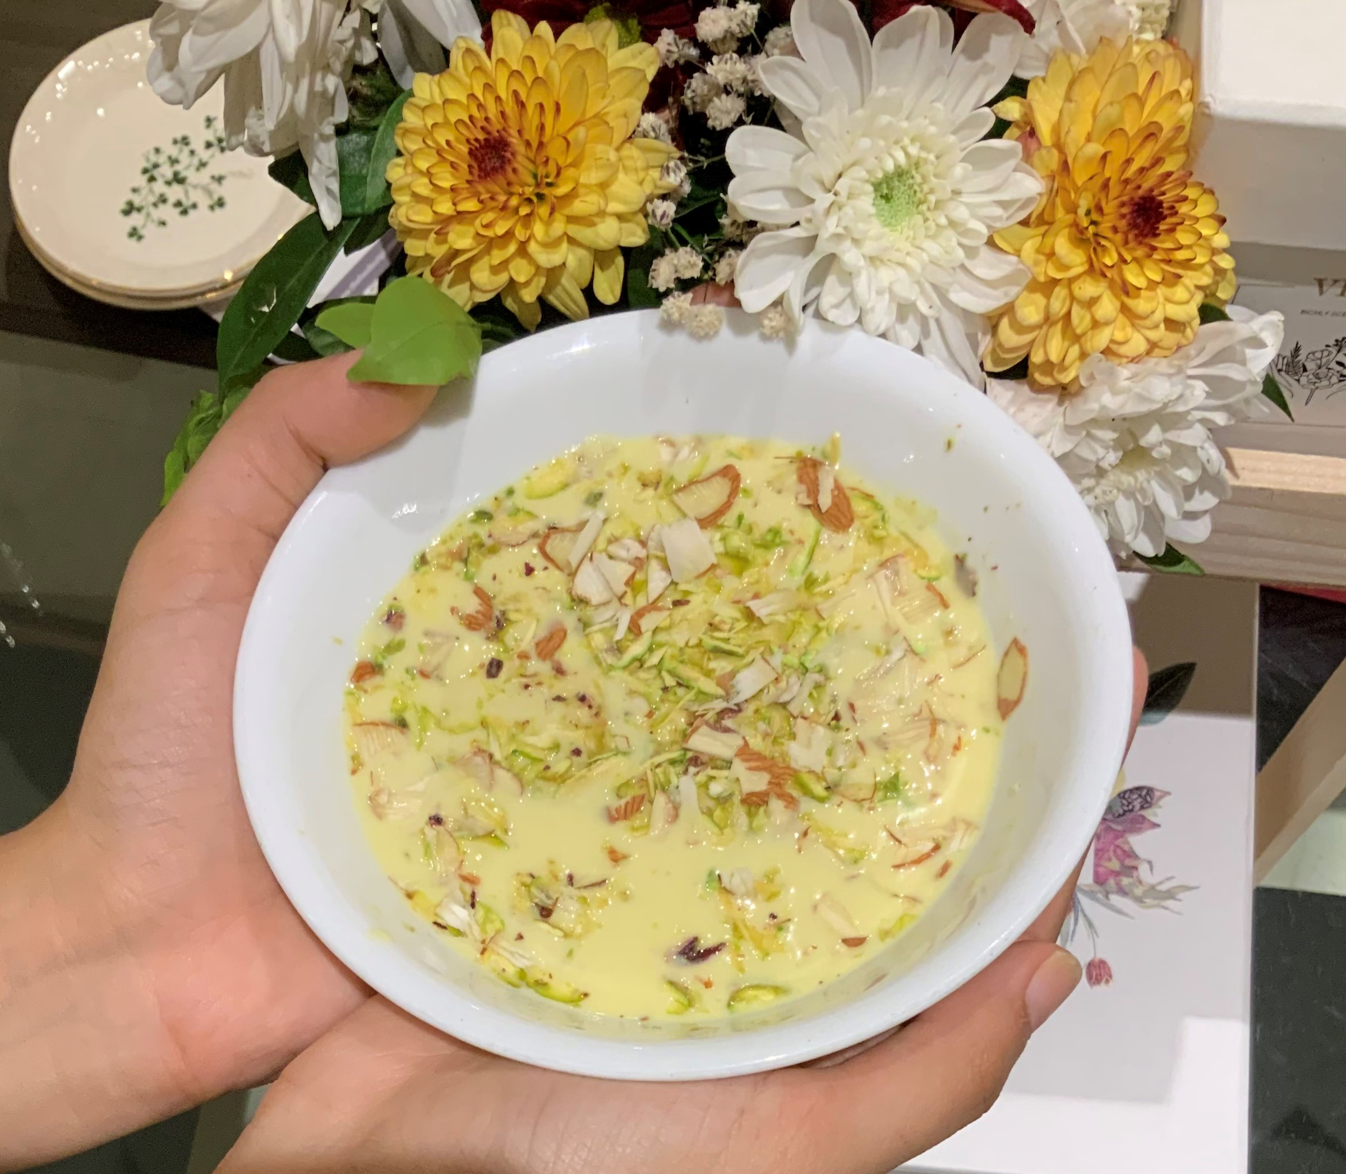
VEGAN RAS MALAI
Ingredients
For the Cheese Cubes:
15 oz firm tofu
½ cup instant soy milk powder or
almond flour
6 tbsp sugar
A few saffron strands
For the milk
1 1/2 cup plant based milk
8 tbsp sugar
2 tbsp of plant based cream
1/4 tsp cardamom powder
Pinch of nutmeg powder (optional)
1/2 tsp of saffron strands
2 tsp slivered pistachio
2 tsp slivered almonds

Slide 9
Method
Blend the tofu with soymilk powder / almond flour, 6 tbsp of sugar and a couple of saffron strands until smooth.
Grease an 8-inch round pan and spread the mixture evenly.
Place the pan in a steamer for 10 minutes or bake in a preheated 300F oven until slightly brown.
Remove from the steamer/ oven and let it cool. The consistency should be like cheese.
When the cheese has set well, cut into one-inch squares and keep in the refrigerator.
In a saucepan, add the milk and 8 tbsp of sugar, cardamom and nutmeg powder and bring to a boil. Simmer for five minutes.
Turn off the heat and allow the milk to cool. Add the cream and beat it till it blends well. Chill in the refrigerator.
Before serving, add the square cheese pieces to the milk and garnish with slivered almonds and pistachios.

