Slide 1
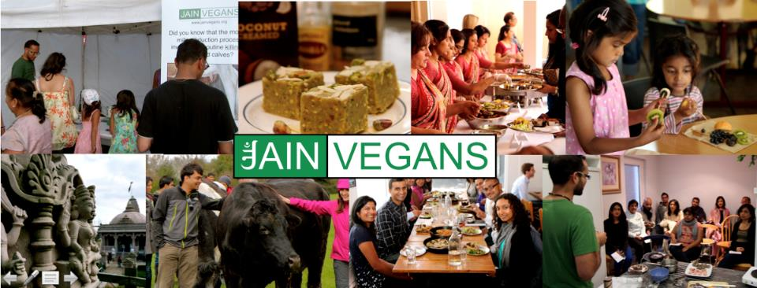
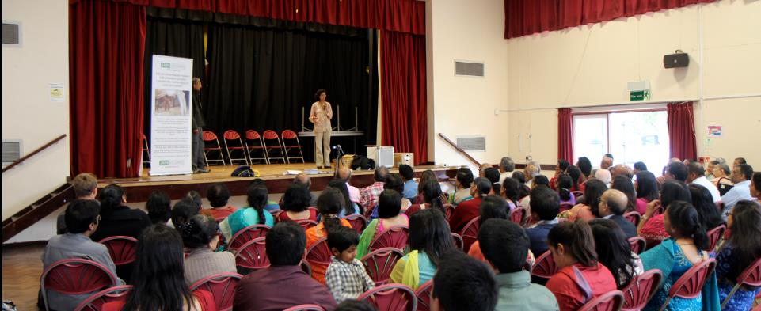
Ethical and environmental issues in modern food: How Jainism helps

Slide 2
Personal introduction: Sagar Shah
Born, raised & live in London, UK
Attended JAINA 2007 (NJ) & studied at International Summer School for Jain Studies in 2013
Worked at environmental campaign group (Friends of the Earth) and think-tank (New Economics Foundation)
Trustee of UK Vegan Society since 2015

Slide 3
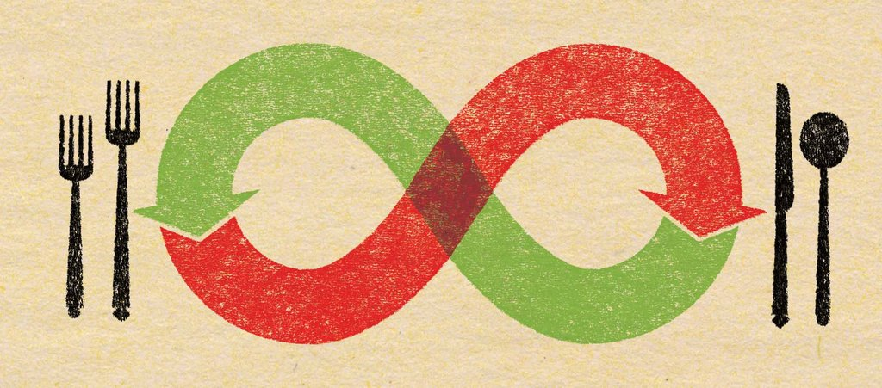
Questions for the audience
Please stand up if you believe we as a community should try and eat in an ethical and sustainable way?

Slide 4
Aim of the talk
Go through some environmental and ethical issues in modern food production, and discuss how Jain principles can help us live a lower himsa, more sustainable life.
Hope you all learn something new

Slide 5
Disclaimer
Not familiar 100% with food production and supply chains in North America
Principles will be similar, but specific examples I refer to which are true in the UK may not be so true in the US.
Also not familiar with pros and cons of genetically modified foods. Production of GM crops largely banned in Europe (except maize in Spain & a weevil resistant potato crop)

Slide 6
Outline
The general challenge
Dairy and eggs
Organic food
Palm Oil
Out of season vegetables
Air-freighted foods
Food waste
How Jainism can help

Slide 7
The general challenge
How much of the world’s land do we dedicate to food production?
* Food & Agriculture Organisation (2011)

Slide 8
The general challenge
The general challenge:
Global population of 7bn, expected to rise to 9bn
37.5% of the Earth’s land used for agriculture*
All land used for farming displaces other forms of life
Live stock accounts for 15% to 50% of greenhouse gas emissions, depending on source and
The general solutions:
Eat less
Choose foods that require fewer resources
Choose foods that are less destructive/violent
* Food & Agriculture Organisation (2014)
Notes:
Obtained from Wolrd Bank Database: http://data.worldbank.org/indicator/AG.LND.AGRI.ZS. 37.5%. Downloaded on 2017.07.03.

Slide 9

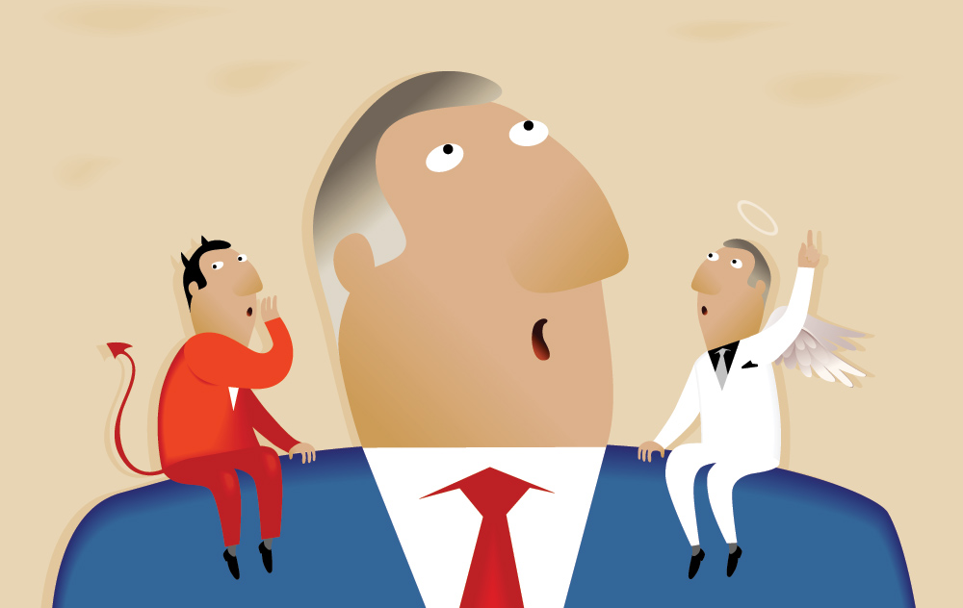
Dairy products
Environmental
Ethical

Slide 10
Environmental impacts
Think about a cup of tea or coffee with a splash of cow’s milk.
Of the greenhouse gas emissions involved in the drink, how much comes from?
Growing the tea/coffee and transporting it
Boiling the water
Adding a bit of milk

Slide 11
Environmental impacts
Source: Mike Berners-Lee (2010) ‘How bad are bananas’
A small splash of milk does more environmental damage than growing and shipping tea/coffee and boiling water.
Notes:
https://www.amazon.co.uk/How-Bad-are-Bananas-Everything/dp/1846688914

Slide 12
Environmental impacts
Source: Mike Berners-Lee (2010) ‘How bad are bananas’
Lattes do a lot more environmental damage than regular drinks
Notes:
https://www.amazon.co.uk/How-Bad-are-Bananas-Everything/dp/1846688914

Slide 13
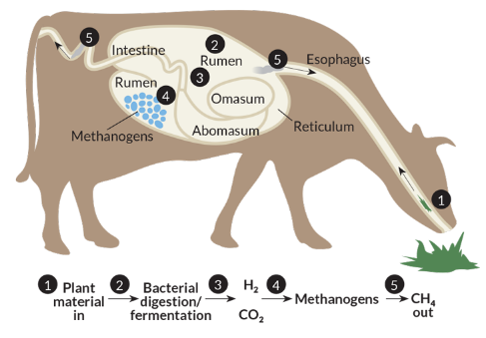
Animals are an inefficient food source
They burn a lot of energy to keep warm
Also need a lot of land and water
United Nations: Livestock cause 15% of greenhouse gas emissions*
Cows account for 60% of this, due to methane
*FAO (2013) Tackling climate change through livestock – A global assessment of emissions and mitigation opportunities
Notes:
Gerber, P.J., Steinfeld, H., Henderson, B., Mottet, A., Opio, C., Dijkman, J., Falcucci, A. & Tempio, G. 2013. Tackling climate change through livestock – A global assessment of emissions and mitigation opportunities.Food and Agriculture Organization of the United Nations (FAO), Rome
http://www.fao.org/3/i3437e.pdf

Slide 14
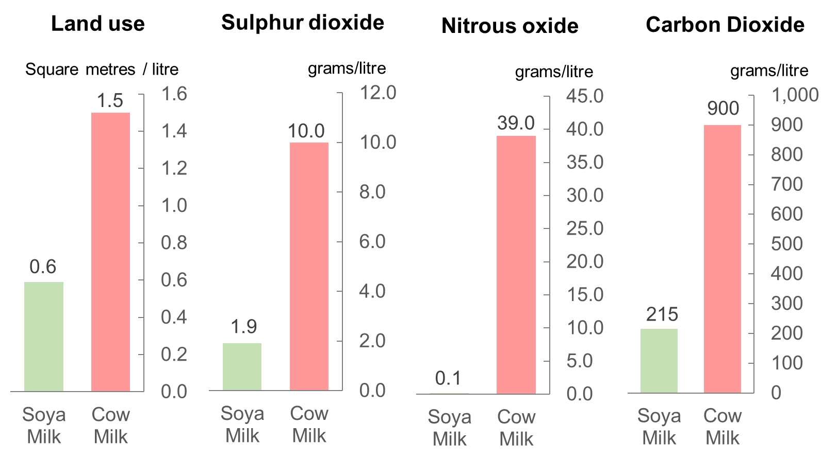
Comparison of soya milk and cow milk
Source: Swedish study – Birgersson et al (2009)
Notes:
Bigersson, Karlsson & Soderlund (2009) ‘Soy Milk - an attributional Life Cycle Assessment examining the potential environmental impact of soy milk’ – unpublished project report supervised by Asa Moberg & Anna Bjorlklund
http://envormation.org/wp-content/uploads/2015/08/Soy-milk-an-attributional-Life-Cycle-Assessment-examining-the-potential-environmental-impact-of-soy-milk.pdf
Downloaded on 2017.07.03

Slide 15
Studies suggest vegan diets appear to be better for climate change
Notes:
Scarborough, P., Appleby, P. N., Mizdrak, A., Briggs, A. D., Travis,R. C., Bradbury, K. E., Key, T. J., 2014, Dietary greenhouse gas emissions of meat-eaters, fish-eaters, vegetarians and vegans in the UK, Climatic Change, DOI: 10.1007/s10584-014-1169-1
https://link.springer.com/article/10.1007/s10584-014-1169-1?sa_campaign=email/event/articleAuthor/onlineFirst

Slide 16
Violence in milk production

Slide 17
Violence in milk production
Forced pregnancy through insemination
Immediate killing of male calves
Premature killing of retired dairy cows

Slide 18
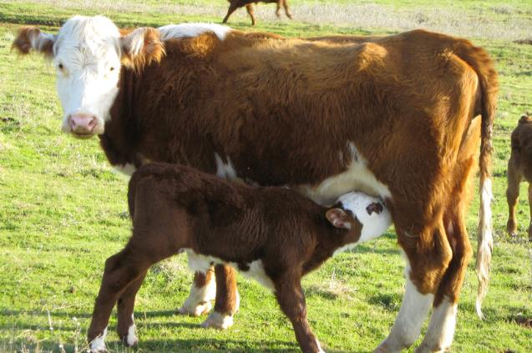
Milk production requires pregnancy
Like humans, cows produce milk to feed their offspring.
Continual milk production requires repeated pregnancy.

Slide 19
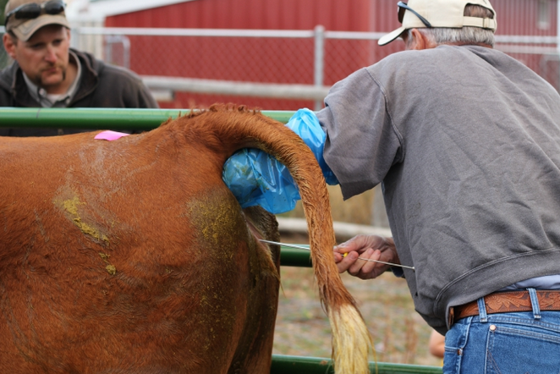
Artificial insemination
To ensure optimal milk production and control costs, cows are forcefully made pregnant approximately once a year through artificial insemination.

Slide 20
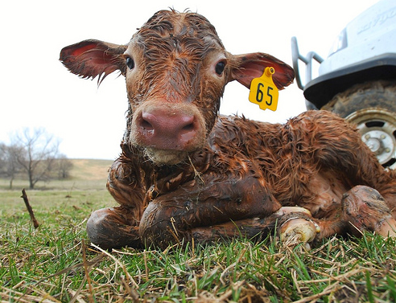
Newborn calves can be male or female
The fate of a newborn calf depends on its gender

Slide 21
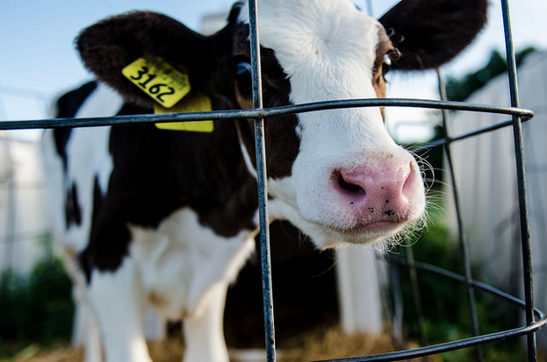
Female calves can produce milk
They can therefore be kept and be made repeatedly pregnant like their mothers.

Slide 22




But male calves have no value alive
Costs to keep male calves alive
Food Water Land Veterinary Bills
Benefits to farmers from keeping male calves alive
Beef? Working on farms? Breeding?

Slide 23
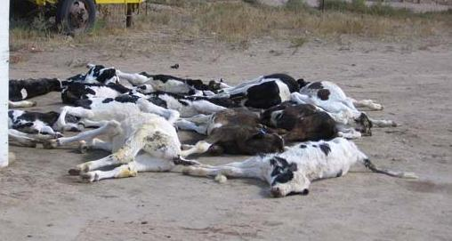
So male calves are killed promptly
They are normally killed within days of being born.

Slide 24
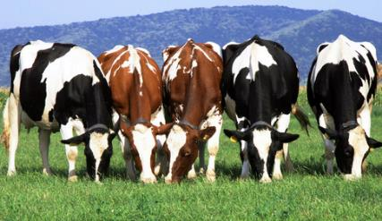
Dairy cows could live for a long time
Life
expectancy
=
18 to 22
years
Notes:
Lifeexpectancy that appears on Google when searching on 2017.07.02

Slide 25
But they are killed when 5-6 years old
Milk production falls after a couple of lactations
More efficient to replace with daughter
Cow population (and associated costs) would explode unless culled
Number of lactations | Av. Number of female offspring
1 | 0.5
2 | 1
3 | 1.5
4 | 2
5 | 2.5

Slide 26
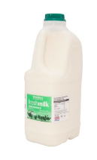
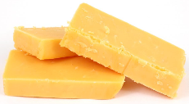
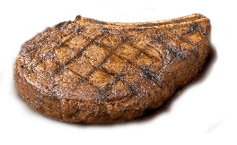
Violence in milk production
Forced pregnancy through insemination
Immediate killing of male calves
Premature killing of retired dairy cows
=
=
350g cheese
¼ Ib steak
6 pints milk

Slide 27
Video

Slide 28
What about in India?

Slide 29
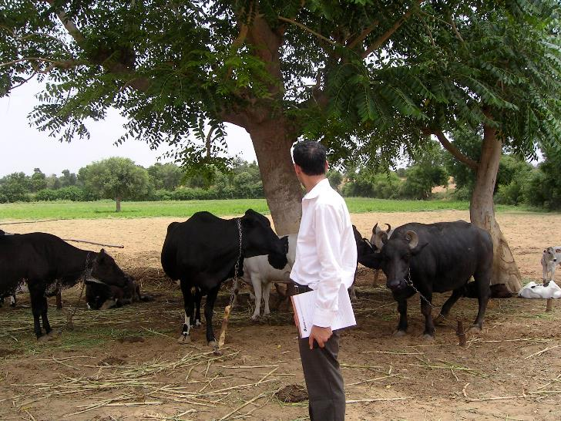
My experience in Indian dairy

Slide 30
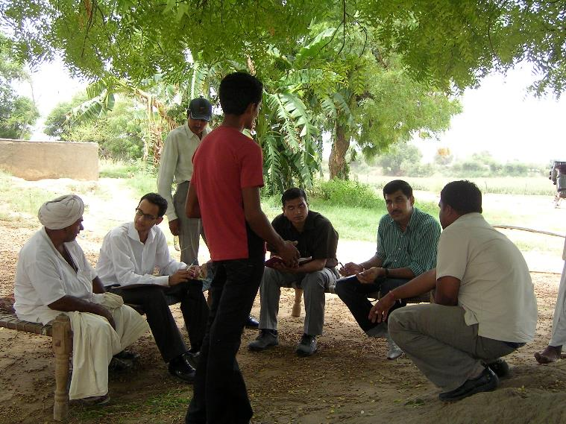
My experience in Indian dairy

Slide 31
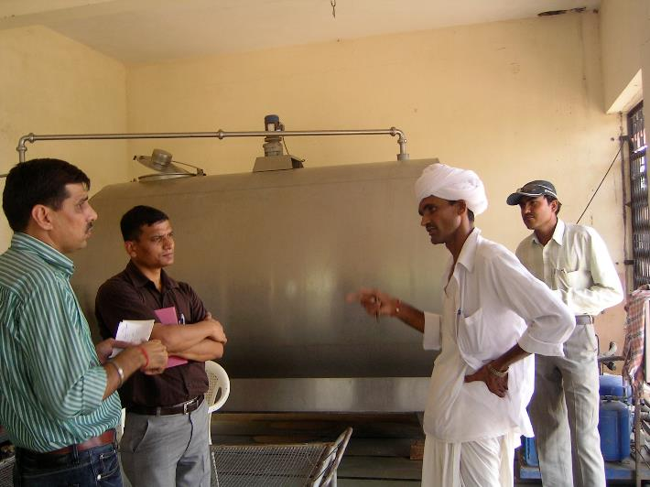
My experience in Indian dairy

Slide 32
Who is the largest beef exporter?

Slide 33
Who is the largest beef exporter?
Notes:
US Department of Agriculture (April 2017) ‘Livestock and Poultry: World Markets & Trade’ Foreign Agricultural Service
https://apps.fas.usda.gov/psdonline/circulars/livestock_poultry.pdf
Downloaded on 2 July 2017.

Slide 34
India is the world’s largest beef exporter
Notes:
US Department of Agriculture (April 2017) ‘Livestock and Poultry: World Markets & Trade’ Foreign Agricultural Service
https://apps.fas.usda.gov/psdonline/circulars/livestock_poultry.pdf
Downloaded on 2 July 2017.

Slide 35
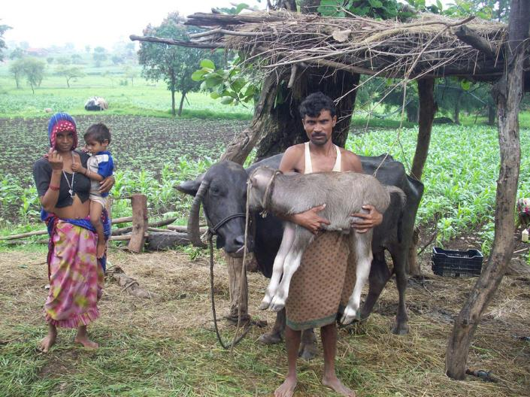
Are male calves killed in India?

Slide 36
What ratio of males to females would you expect to see if there was no killing of male calves?

Slide 37
Are male calves killed in India?
Notes:
Press Information Bureau | Government of India | Ministry of Agriculture
Salient Features of 19th Livestock Census
Published 03-September-2014 15:19 IST
http://pib.nic.in/newsite/PrintRelease.aspx?relid=109280
Downloaded 2 July 2017

Slide 38
What happened to the missing males?
Notes:
Press Information Bureau | Government of India | Ministry of Agriculture ‘Salient Features of 19th Livestock Census’
Published 03-September-2014 15:19 IST http://pib.nic.in/newsite/PrintRelease.aspx?relid=109280
Downloaded 2 July 2017

Slide 39
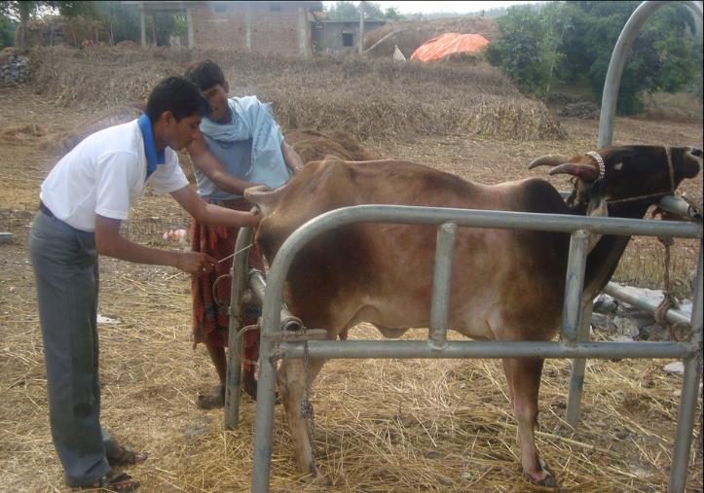
Does artificial insemination happen in India?

Slide 40
There were 63m artificial inseminations in India in 2015
Artificial Inseminations / year in India
# inseminations as a % of adult female cows/buffaloes
63
Source: National Dairy Development Board (India)
Source: National Dairy Development Board (India)
& Indian Livestock Census
Notes:
http://www.nddb.org/information/stats/insemination
http://www.nddb.org/information/stats/pop

Slide 41
Dairy: recommendation
Give up dairy as soon as you can.
Replace with plant-based alternatives, such as those made from soya, coconut, almond, cashew, hemp rice.
Encourage others to do so and support charities that do animal advocacy work.
* Ponisio et al (2014): Meta-analysis of 114 studies

Slide 42


Organic food
Hands up if you think we should aim to eat more organic food?

Slide 43
Organic food
The pros
The cons
No artificial fertilisers
No artificial pesticides
Encourage crop diversity
Animal blood/bones used instead of petroleum based chemicals
Cows/calves still killed in organic milk production.
Predatory insects introduced to deal with pests
Yields around 20% lower*
* Ponisio et al (2014): Meta-analysis of 114 studies
Notes:
L.C. Ponisio, L.K. M’Gonigle, K.C. Mace, J. Palomino, P. de Valpine, C.Kremen
Diversification practices reduce organic to conventional yield gap
Proc. Royal Soc. B, 282 (2014), p. 20141396
http://rspb.royalsocietypublishing.org/content/282/1799/20141396
Downloaded on 2 July 2017

Slide 44

No easy solution
Vegan organic farming in the UK appears better aligned with Jain principles.
But yields are low and hard to obtain

Slide 45
Recommendation: Organic
Organic fruits, vegetables and grains are still probably better than conventional alternatives.
But lower yield means we should aim for less land-intensive foods.
Why not grow your own vegetables?
Support organisations promoting vegan organic farming methods.

Slide 46
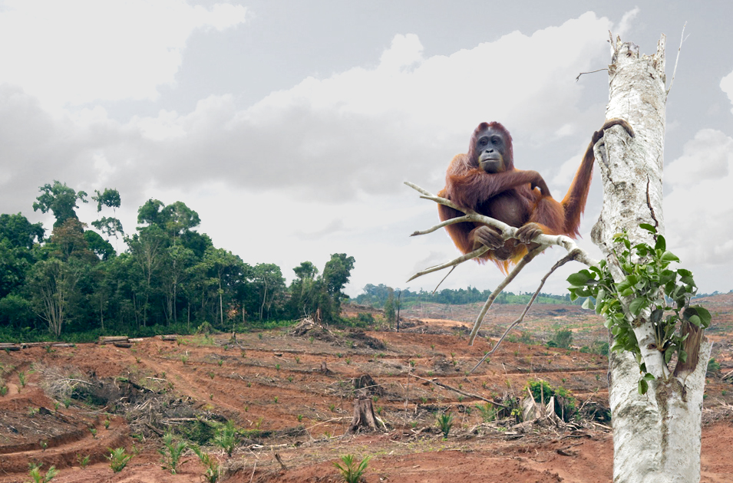
Deforestation from Palm Oil & Soya?

Slide 47
Deforestation from Palm Oil & Soya?
Soya
Highest yield of edible protein per unit of land
Primary rainforest destruction in the Amazon basin. Often GM and/or highly sprayed.
Most soya is used for animal feed.
Palm oil
One of the most productive crops per unit of land.
Used in many foods, including dairy-free alternatives to butter. Often not labelled.
High in saturated fat.
Primary rainforest deforestation in Malaysia and Indonesia.

Slide 48
Do we need palm oil or soya?
Neither palm oil nor soya our necessary in our diet.
Most of us eat more fat than we need.
When we do eat fat we should aim for healthy sources like whole nuts, seeds and avocadoes rather than refined oils.

Slide 49
Soya is one of the most efficient crops
Usable protein, gm/m²
Source: https://en.wikipedia.org/wiki/Edible_protein_per_unit_area_of_land

Slide 50
Recommendations: deforestation
Avoid palm oil as far as possible.
Where fat labelled “vegetable fat”, probably palm oil if >30% fat is saturated.
Soya is a very efficient protein source.
Go for lightly processed soya foods where source and production method is transparent.

Slide 51
Comparison of carbon costs
Which has a higher carbon footprint?
1kg of beef
1kg of tomatoes

Slide 52
Depends on how tomatoes are grown
Source: Mike Berners-Lee (2010) ‘How bad are bananas’
Notes:
https://www.amazon.co.uk/How-Bad-are-Bananas-Everything/dp/1846688914

Slide 53
Seasonality matters
Crops grown while in season, have low carbon footprints.
But crops grown in heated greenhouses are often worse for the environment than meat.

Slide 54
Recommendation: Seasonal foods
Find out about seasonality in your local area.
Join a box scheme / grow your own.
May be better to consume tinned tomatoes than fresh tomatoes during winter.
Beans/pulses and grains store well so seasonality is not an issue.

Slide 55
Food transport methods
Lets say you live in New Jersey, and want to purchase some produce from California.
How do transport methods compare in terms of their contribution to global warming?

Slide 56
Food transport methods
g CO₂e / metric ton
500
60 to 150
30 to 100
10 to 40
Source: Time for Change, Flugaerm
Notes:
http://timeforchange.org/co2-emissions-shipping-goods
Downloaded on 2 July 2017

Slide 57
Example: Asparagus
kg CO₂e / kg
Source: Mike Berners-Lee (2010) ‘How bad are bananas’
Notes:
https://www.amazon.co.uk/How-Bad-are-Bananas-Everything/dp/1846688914

Slide 58
Food transport methods
Airfreighted products are an environmental disaster due to long distances.
Products that are air freighted tend to be highly perishable (e.g. Indian mangoes, papaya, berries, asparagus, fresh flowers)
But some products (e.g. bananas, oranges, apples) are normally transported by ship/truck.

Slide 59
Recommendations: transport methods
Avoid air-freighted products if possible
Go for in-season fruits, dried versions, or foods transported by ship/truck.
Lentils and grains/pulses tend to good all year-round. Non-perishable and transported by ship.

Slide 60
Food waste
How much of food that we buy in the West is thrown away?

Slide 61
Food waste
In the UK, estimated that a third of all foods bought are thrown away!*
* WRAP (2008) The Food We Waste: A study of the amount of food we throw away in UK households
Notes:
* WRAP (2008) The Food We Waste: A study of the amount of food we throw away in UK households
http://collections.europarchive.org/tna/20100907111047/http:/wrap.org.uk/downloads/summary_v21.0218b6a2.5460.pdf
Downloaded on 10 August 2017.

Slide 62
Recommendation: Food waste
Eat what you buy!
Non-perishable foods like dried lentils/pulses/beans and whole grains are good!

Slide 63
Summary of recommendations
Eat less. Buy less. Waste Less.
Avoid dairy products. Use alternatives.
Avoid palm oil.
Avoid air-freighted goods and non-seasonal greenhouse heated foods.
Go for seasonal, local or shipped foods.
Pulses and grains good all year round.

Slide 64
Sounds hard? How Jainism helps!
Fasting
Mindful eating
Cultivating detachment
Pulses and grains: Tithi days, Ayambil

Slide 65
Thank you. Questions.

