Slide 1

Ahimsa Parmo Dharmo
Live & Let Live Vegan way
Ahimsak (Vegan) Lifestyle:
Caring for Animals, Environment, Body and Soul
- Sanjay Jain

Slide 2
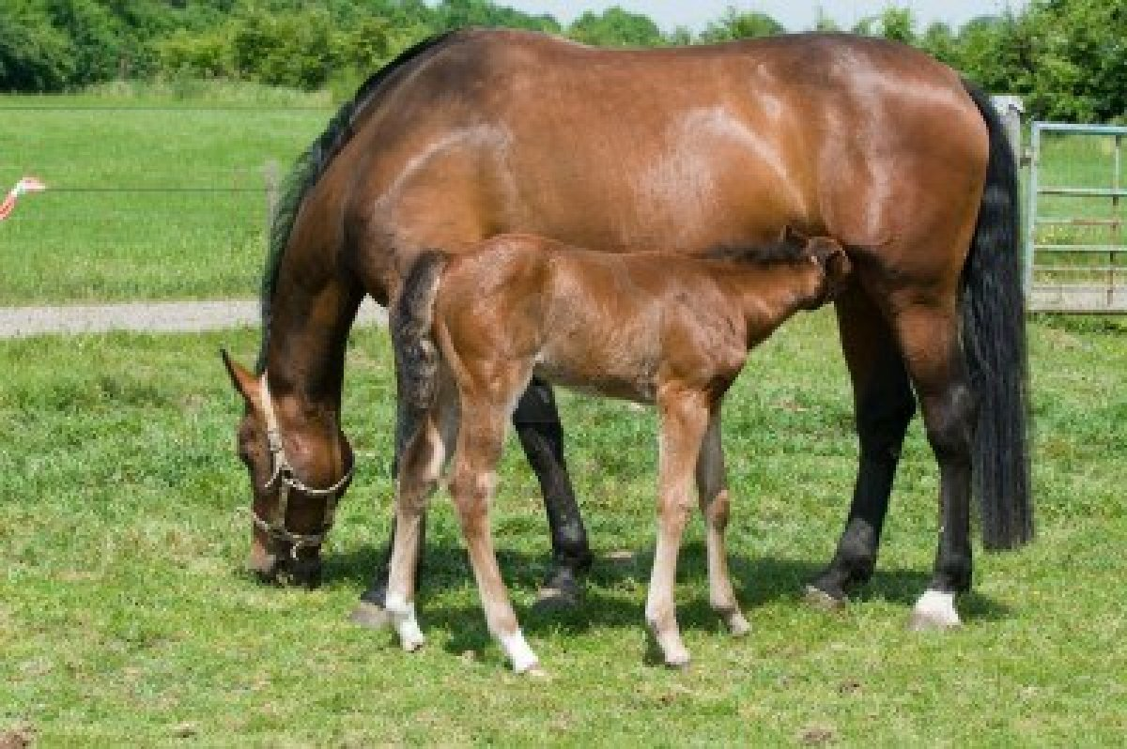
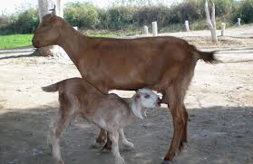
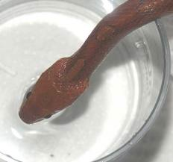
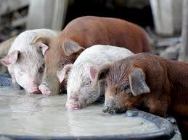
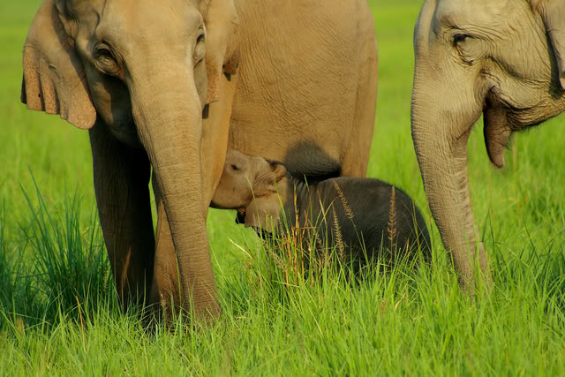
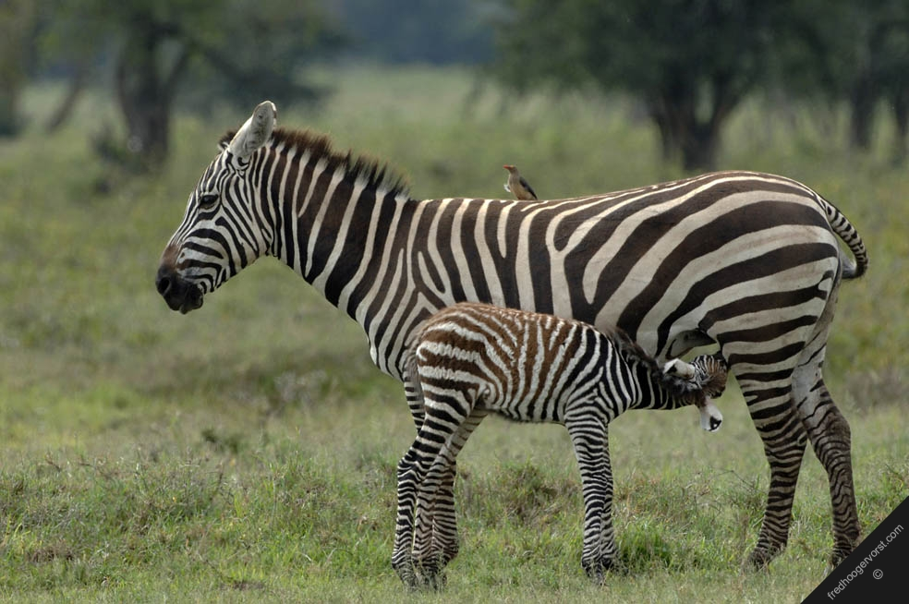
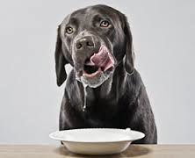
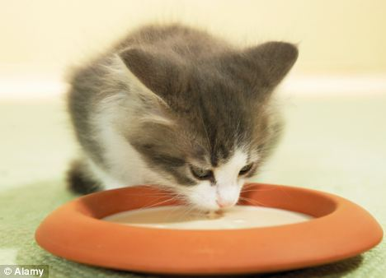
Vegetarian: Nature’s Definition
Vegetarian animals drink milk of their own mother when infant. Adult refuse milk even if offered
Non Vegetarian animals drink milk in adulthood if offered

Slide 3
Vegetarian: Our definition
History: formed irregularly from vegetable + arian
शाकाहारी: फल सब्जी खाने वाला
Dictionary.reference.com: lacto·vegetarian, also called lactarian, a vegetarian whose diet includes dairy products
Wiki: ovo-vegetarian diet includes eggs but not dairy products, a lacto-vegetarian diet includes dairy products but not eggs, and an ovo-lacto vegetarian diet includes both eggs and dairy products. A vegan, or strict vegetarian, diet excludes all animal products, including eggs, dairy, beeswax and honey

Slide 4
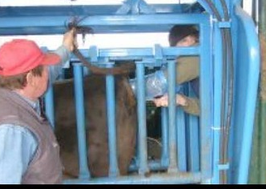
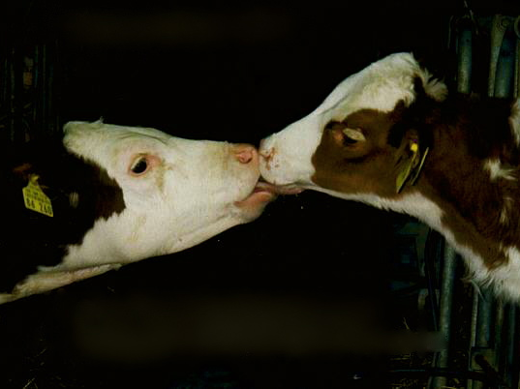
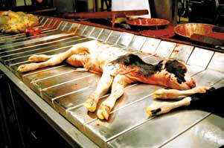
The life of a dairy cow
Dairy cows are kept artificially impregnated 300 days in a year. Restraining apparatus is often called “Rape Rack”.
Within minutes after birth, calves are separated from their mothers. Mothers are known to cry for weeks for calves.
Male calves are taken away for veal and calfskin production.

Slide 5
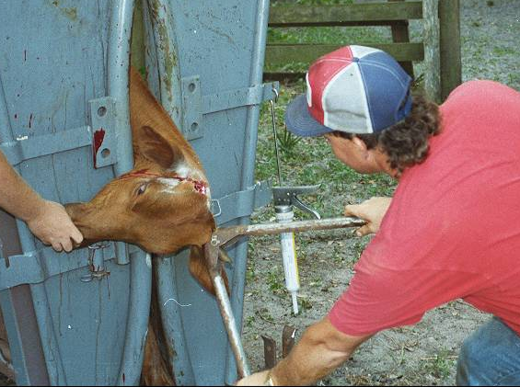
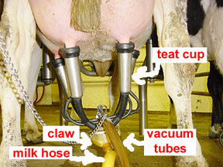
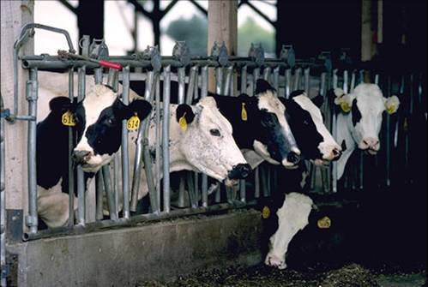
The life of a dairy cow
Once the cows are old enough to start producing milk, they are forcefully dehorned (a process as painful as pulling out our nails) without any painkillers.
Cows are mostly hooked up to instruments which increase their discomfort and chance of disease.
Dairy cows spend most of their short lives, cramped and confined. Their hooves never touch grass, only a concrete floor.

Slide 6
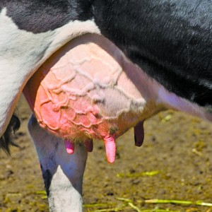
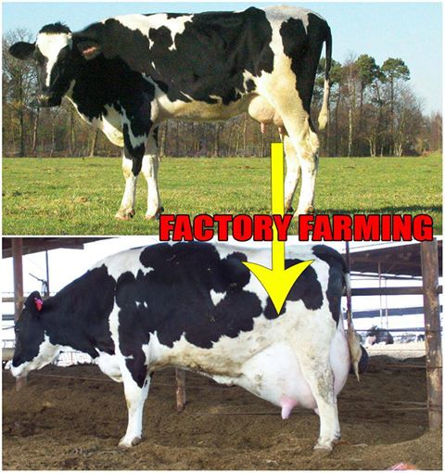
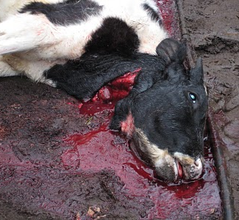
The life of a dairy cow
Mechanical milking causes painful diseases, such as mastitis but often the cows are left untreated because the medicine can leak into the milk, and make it impossible to sell.
They are given artificial growth hormones and antibiotics to produce more than 4 times the natural amount of milk.
A cow’s natural life span is 20 years, but they will only live for 5-6 years. Once their milk has dried up, they will be sent to the slaughter houses for leather and beef.

Slide 7
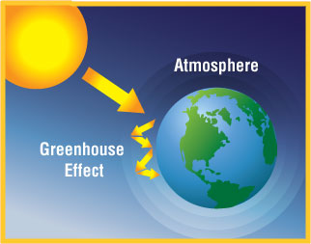
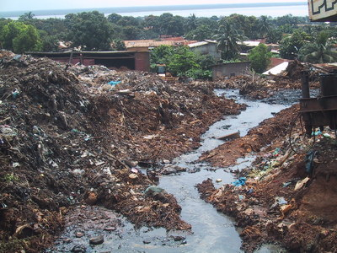
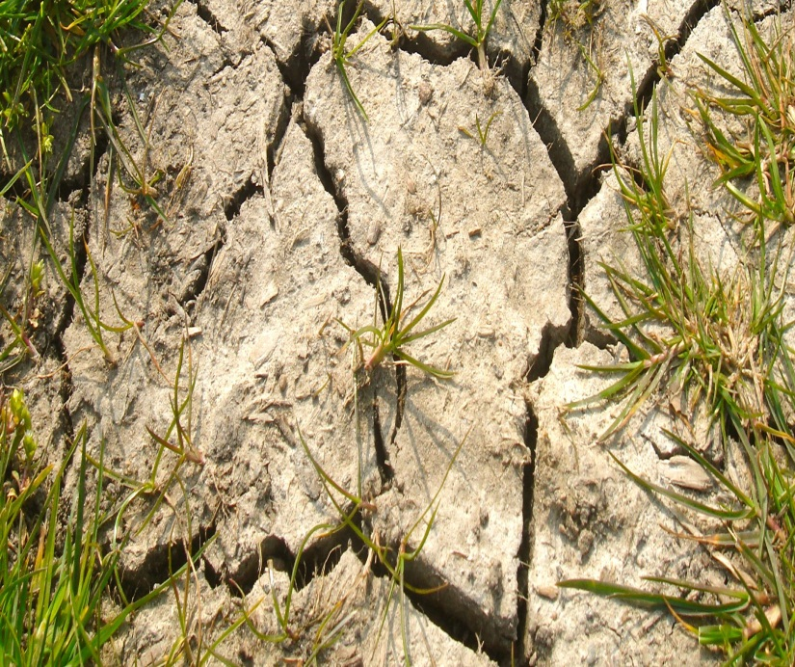
Dairy Impacts Air, Water and Land
  Dairy farms accounts for 40% greenhouse gases: CO2, methane and nitrous oxide
  Dairy farms uses 8% water resources and pollutes both ground and surface water
  Dairy farms livestock is occupying 70% agricultural land and causes soil erosion and compaction

Slide 8
United Nations links non-vegan diet as top contributor to most serious environmental problems
The livestock sector emerges as one of the top two or three most significant contributors to the most serious environmental problems, at every scale from local to global.
The findings of this report suggest that it should be a major policy focus when dealing with problems of land degradation, climate change and air pollution, water shortage and water pollution.
Source: http://www.fao.org/agriculture/lead/lead-resources/newsletter2/newsletter-09/en/

Slide 9

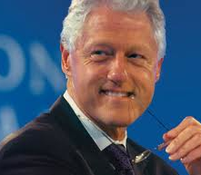
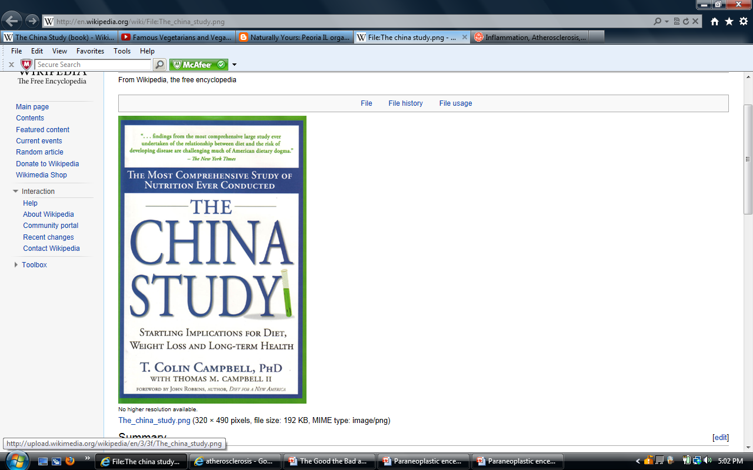
Health benefits of Veganism
A Vegan Diet Can Reverse Heart Disease – A case study by Dr. Esselstyn. 5 years of vegan diet reversed the clogged artery.
“The Last Heart Attack” CNN documentary: Bill Clinton turned to Vegan after continuous blockage of his arteries even after 4 bypass surgeries.
People who eat a plant-based/vegan diet and avoid refined carbohydrates will escape, reduce or reverse the development of chronic diseases such as Heart disease, Diabetes and Cancers

Slide 10
Kaiser (leading health insurance company) recommends Vegan diet
Physicians should consider recommending a plant-based diet to all their patients, especially those with high blood pressure, diabetes, cardiovascular disease, or obesity
This may also reduce the number of medications needed to treat chronic diseases and lower ischemic heart disease mortality rates
EPIC-Oxford study
Non-meat eaters, especially vegans, have a lower prevalence of hypertension and lower systolic and diastolic blood pressures than meat eaters

Slide 11
Does Jainism promotes Veganism? - Judge it yourself
Ahimsa Parmo Dharma (Non-violence is supreme religion): Jainism is based on this principle.
  When in doubt, use the above principle.
  Do you think consuming dairy is non-violence?
Jainism preaches to not own pets like dog, cat, birds since you limit the freedom. Shouldn’t this applies to cows?
Isn’t milking cow is stealing milk?
Jainism promotes non violence towards single sense living being. Cows are five sensed with thinking capabilities.
Jainism mentions six “Ras Tyag” (Sweet, Salt, Oil, Ghee, Milk and Yogurt). Being vegan makes you giving up three Ras: Ghee, Milk & Yogurt

Slide 12
India is biggest beef exporter in the world
According to the Ministry of Food Processing Industries, India has 3,600 slaughterhouses
According to the U.S Department of Agriculture’s report, India became the biggest beef exporter in the world in 2012 with 1,680,000 tones of beef and veal exports
Do you know that about 10,000 cows comes to slaughter house every day in India alone?
Source: http://www.thehindu.com/todays-paper/tp-features/tp-sundaymagazine/whats-behind-that-glass-of-milk/article4685099.ece#.UYZGXXRQiCw.email

Slide 13
Slaughter Houses – What is the real option?
When the cows are not profitable to dairy industry at the age of 5-6 years, leave the cows on the street
In India alone, open one Gaushala (cow shelter house) of capacity 10,000 cows every day for next 15 years so that cows can live the rest of life after they are not profitable to dairy industry. (In US the figure is 115,000 cows)
Real option: Stop consuming dairy product so that cow farming is stopped

Slide 14
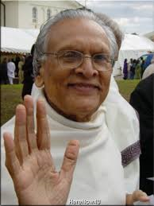
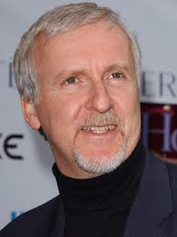
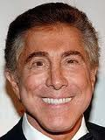


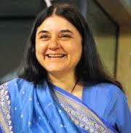
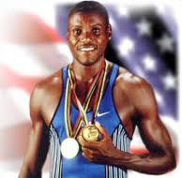
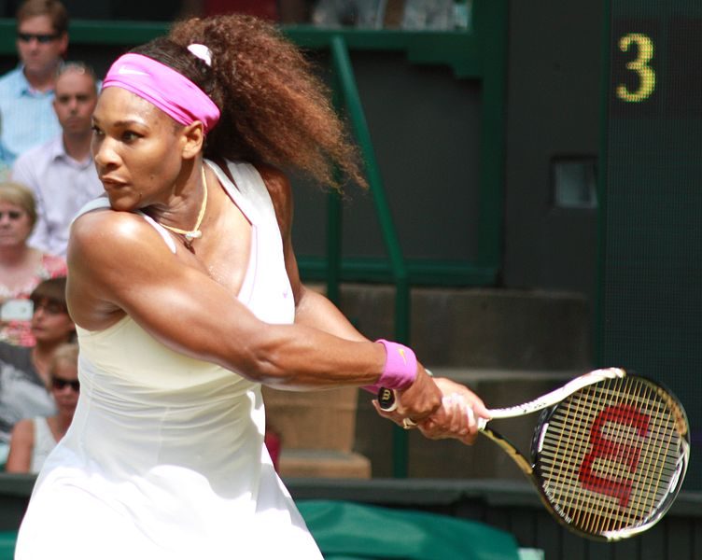


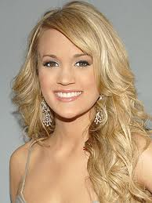
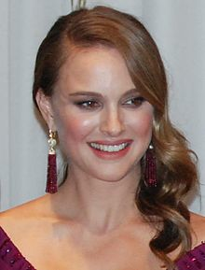
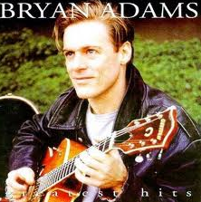
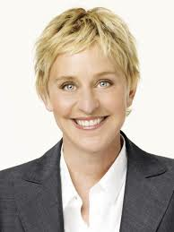
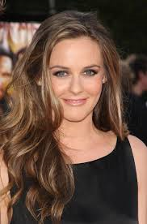
Gurudev Chitrabhanuji
James Cameron
Steve Wynn
Brad Pitt
Tobey Maguire
Vegan celebrities
Maneka Ghandhi
Carl Lewis
Serena Williams
Venus Williams
Anne Hathaway
Carrie Underwood
Natalie Portman
Bryan Adams
Ellen DeGeneres
Alicia Silverstone

Slide 15
Transform to Vegan
Read about vegan topics, do research on web yourself
Transform slowly with friends, family or community
Integrate Vegan items into your diet one by one
Start Vegan diet for few days like 1 day/week. Try observing vegan diet during Paryushan/Das Lakshan
Use almond oil instead of ghee in Aarti at temple
Temples should try to serve Vegan only meal during main events like Diwali program
Try PCRM 21 day Vegan kick start by Dr. Neal Bernard
The survey of 2000 people converted to Vegan concluded that transitioning to vegan diet is effortless and most people feel healthier and energetic after the transition

Slide 16
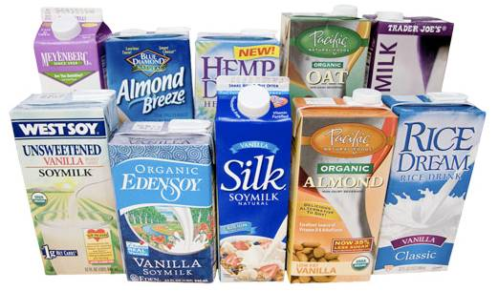
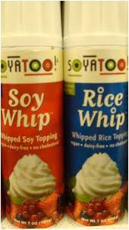
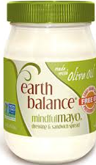
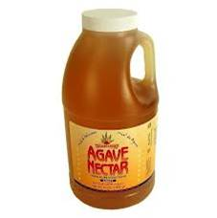
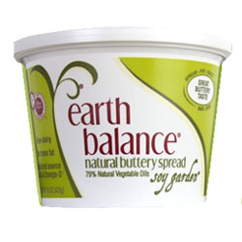
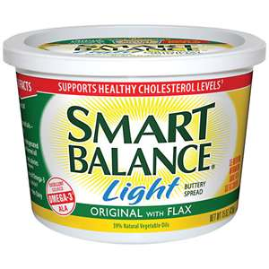
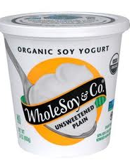
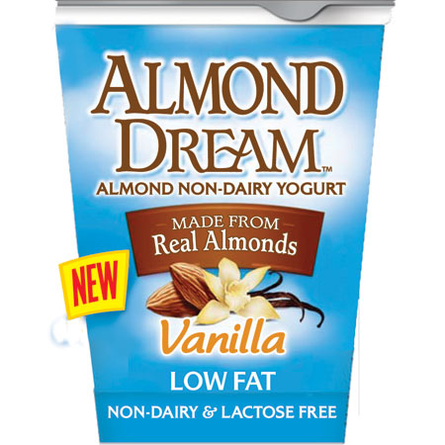
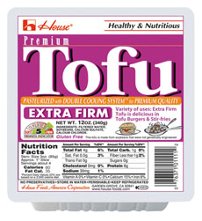
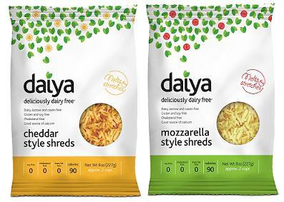
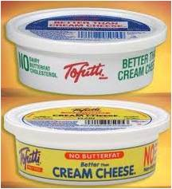
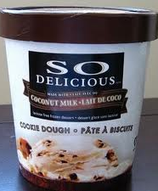
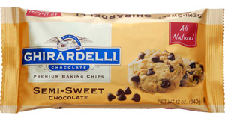
Milk
Whip Cream
Mayonnaise
Honey
Vegan Substitutes
Butter
Yogurt
Paneer
Cheese
Cream Cheese
Ice Cream
Chocolate Chip

Slide 17
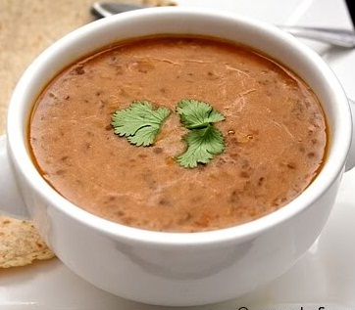
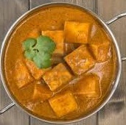
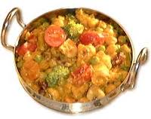
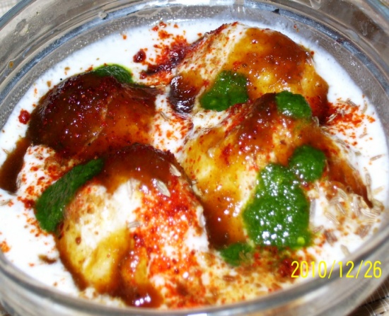












For dishes with Malai/Heavy cream, use Cashew/Makhana paste
For dishes with yogurt, use soy yogurt
Vegan Tips for Jain Kitchen
For dishes with Ghee,
Use vegetable/peanut oil
For dishes with Milk,
use soy/almond milk
For dishes with Paneer,
use Tofu
For dishes with Egg,
use egg replacer
1 egg = 2 Tbsp. water + 1 Tbsp. oil + 2 Tsp. baking powder

Slide 18
Drinking your mother’s milk is your mother’s choice and your right
Drinking cow’s milk is neither cow’s choice nor your right
- Sanjay Jain
No mother would like to become artificially pregnant only to offer milk to others
- Sanjay Jain

